Slide 1
“Protection for investors and depositors in the Canadian brokerage/banking industry” for the IIROC - Conduct, Compliance and Legal Advisory Section November 2, 2017
Dean Cosman, Senior Vice-President, Insurance & Risk Assessment
Canada Deposit Insurance Corporation

Slide 2
Today’s Presentation
Background
Coverage: General
Coverage: Brokered Deposits

Slide 3
What is CDIC?
A federal Crown corporation created by Parliament in 1967.
CDIC protects Canadians’ deposits against the failure of a bank or other CDIC member institution.
CDIC is the resolution authority for all its members.
CDIC collaborates with other federal agencies to help keep Canada’s financial system strong.

Slide 4
Our financial safety net partners
Canadian Regulatory/Supervisory System
Federal
Provincial
Parliament
Legislatures
Minister of Finance
Ministers of Finance
Department of Finance
OSFI
FCAC
CDIC
Bank of Canada
Provincial Regulators
Mechanisms to coordinate actions & share information (SAC, FISC, CDIC BoD)
Canadian Payments Ass’n
Provincial Deposit Insurers
Foreign RAs (MOUs)
Domestic Partners (IIROC, CIPF MOUs)

Slide 5
What do we do?
Parliament established CDIC in 1967, to:
provide insurance against the loss of part or all of deposits;
promote and otherwise contribute to the stability of the financial system in Canada;
act for the benefit of depositors while minimizing loss.
On June 23, 2017, Parliament expanded CDIC’s objects: “to act as the resolution authority for its members”.
CDIC’s tools include: financial assistance, selling or restructuring the member institution, and creating a bridge bank, all of which keep the member institution operating for Canadians without interruption.
If an member institution must be closed and liquidated, CDIC’s objective is to reimburse most deposits within three business days.

Slide 6
CDIC governance
Board of Directors
Chairperson
5 ex-officio public sector members
Governor of the Bank of Canada
Deputy Minister of Finance
Commissioner of the FCAC
Superintendent of Financial Institutions
Deputy Superintendent, OSFI
5 private sector members

Slide 7
CDIC Strategic Objectives
Focused on four key areas:
Member risk management and resolution preparedness
Modernizing the Deposit Insurance Program
Stakeholder engagement/public awareness
Our people

Slide 8
Our members
Membership is automatic for banks (including FCUs) and federally chartered trust and loan companies - if they take retail deposits.
Securities dealers, deposit brokers, securities firms, foreign bank branches (sched III), and provincial credit unions are NOT CDIC members.
CDIC currently has 82 members.
Insured deposits of over $770 billion (as of September 2017).

Slide 9
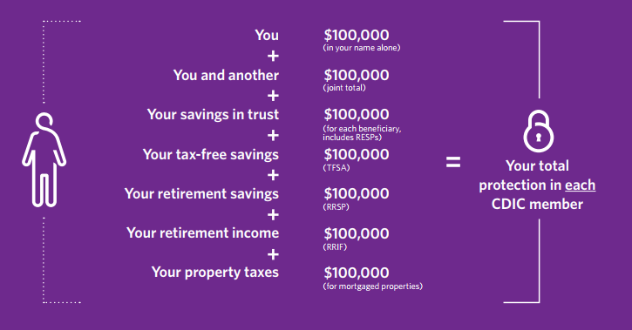
Deposit coverage
CDIC covers eligible deposits up to $100,000 per person, per CDIC member, in each of seven separately protected coverage categories:
CDIC does NOT cover: foreign currency deposits, term deposits with an original term that exceeds 5yrs, deposits in respect of which the principal is not protected, mutual funds, stocks, bonds.

Slide 10
How is CDIC Funded?
CDIC is funded by its members through premiums:
Differential premium system – four premium categories
Rates for 2017: 6.5bp, 13bp, 26bp, 33.33bp of insured deposits
CDIC maintains an ex ante fund – target is minimum 100bps of insured deposits:
At 52 bps (as at y/e - March 31, 2017).
Forecast to reach 100bps in 2024 / 2025 fiscal year.
In addition, CDIC has ability to borrow from the Government (CRF) or capital markets – current borrowing authority $22 billion (increased annually indexed to growth in insured deposits).
Additional funding available through Appropriation Act.

Slide 11
CDIC’s role in a failure
While approach to resolution dependent on institution and circumstances, in all cases, CDIC seeks to provide access to insured funds in a timely manner.
Non-DSIB:
Pay out and liquidations - CDIC promptly pays insured depositors (most deposits within 3 business days) and the failed entity is wound up (under WURA). CDIC becomes a large creditor of the estate.
Non-Payout resolution (e.g. Purchase & Assumption Agreements) - CDIC (financially) assists another member to acquire the failed member institution.
DSIBs – resolution planning under way with new tools (e.g. bail-in) to ensure DSIB can remain open with losses absorbed by debtholders and shareholders rather than taxpayers.

Slide 12
Coverage – Trust Deposits
Trusts deposits include professional trust accounts, standard savings trust deposits, and nominee brokered deposits.
Note: if a broker acts as an agent for their client (i.e. place deposits in client name), no trust is established.
Separate coverage (up to $100,000) can extend to each beneficiary, ONLY IF the trustee provides the required beneficiary information to the member institution for inclusion on its records.
Deposits held by the same broker (the depositor) for the same client/beneficiary at a single member institution are aggregated → i.e., coverage per beneficiary would not exceed $100k.
Deposits held by different nominee brokers for the same individual at a single member institution are not aggregated for coverage purposes, as the depositor (i.e. the broker) for each deposit is different.

Slide 13
Coverage – Trust Deposits
To qualify for separate coverage and allow for prompt reimbursement, the MI’s records must contain key information:
The trusteeship (indicator of a valid trust)
The name and address of the nominee broker (as trustee/depositor)
The name & address of the beneficiaries (i.e. the broker client)
The interest of each beneficiary (amount or percentage) in the deposit.
Nominee brokers may provide alphanumeric identifiers (IDs) in lieu of client names/addresses when making deposits with MIs.
Must be a separate code in respect of each client/ beneficiary (one ID/client)
The same ID must be used for each deposits made by a broker at an member institution for which client is a beneficiary
Broker must maintain up-to-date beneficiary names/addresses on their records.

Slide 14
Coverage – Trust Deposits
Nominee brokers are responsible to disclose information to MIs.
MIs annually contact nominee brokers (and other trustees) who hold multi-beneficiary deposits to request pertinent beneficiary information (e.g., percentage of beneficial interests), that assists CDIC in fulfilling its role.
If improperly reflected on MI’s records at time of failure, reimbursement may be delayed and / or total coverage may be reduced. At time of failure beneficial interests can be updated but new beneficiaries cannot be added.
To ensure clients are appropriately covered and can be reimbursed promptly brokers should:
Take steps to ensure that beneficiary information (e.g., client IDs, beneficial interest, etc.) is provided to MIs at the time of setting up the deposit.
Use the annual update process to provide this info if missing and/or to update information if it has changed.

Slide 15
Coverage – Trust Deposits
More information can be found on our website – www.cdic.ca
CDIC has issued information bulletins on the matter in the past and will continue to reinforce the message with the broker community.
June 2017 - http://www.cdic.ca/en/financial-community/legislation-bylaws/Pages/important-information-for-broker-trustees.aspx
March 2010 - http://www.cdic.ca/en/financial-community/legislation-bylaws/Documents/InformationBulletinMar2010.pdf

Slide 16
On the horizon…
Deposit Insurance Review (Department of Finance)
As announced in Budget 2014
Focus on streamlining Deposit Categories / updating scope of coverage / addressing complexities of trust deposits
Consultation are ongoing - outcomes could result in legislative changes
2019 Legislative review (Department of Finance)
Budget 2016 extended sunset clause from March 29, 2017 to March 29, 2019
Opportunity for stakeholders (including CDIC) to suggest legislative changes
May result in legislative changes to CDIC Act

Slide 17
Thank You!
Contact info: dcosman@cdic.ca

